Slide 1

FX Statistical Arbitrage: Residual Relative Momentum Strategy (Hybrid Concave Variant)
Presented by: Team BeatCoin.AI | Arbitrage Arena (Stage 2)
Dhruv Agrawal, Manipal Institute of Technology (2nd Year BTech) Shreyas B S, Manipal Institute of Technology (2nd Year BTech)

Slide 2
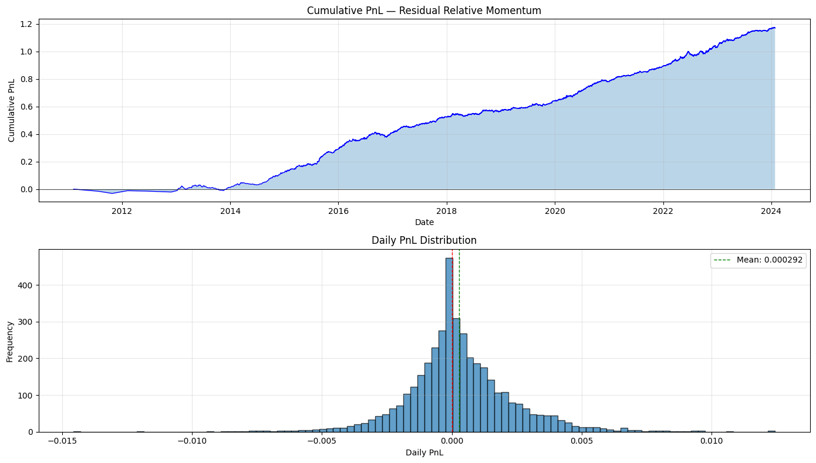
FX Statistical Arbitrage: A Familiar Idea That Keeps Failing
FX statistical arbitrage is built on a simple, appealing intuition: correlated currency pairs temporarily diverge from their equilibrium relationships and then predictably revert to historical norms. For decades, this concept has attracted quantitative traders seeking to profit from temporary mispricings in the foreign exchange market.
Graphs of our model created for the dataset provided.
At high frequency horizons, however, this intuition repeatedly fails once we enforce three critical real-world constraints: strict causality that prohibits any use of future information, market neutrality requirements that prevent directional exposure accumulation, and realistic transaction costs that reflect actual trading conditions.
This project began by confronting a fundamental question that challenges the theoretical foundation of most FX statistical arbitrage approaches: Why do strategies that appear robust in backtests consistently fail when deployed in live market conditions?

Slide 3







What the Competition Actually Enforced
ARBITRAGE ARENA STAGE 2
The Arbitrage Arena Stage 2 problem removed nearly all common shortcuts that typically mask strategy weaknesses in academic research. This competitive framework imposed a rigorous set of constraints that mirror real-world institutional trading requirements, forcing participants to confront the true complexity of high-frequency FX arbitrage.
Data Constraint
5-second OHLCV bars only: no tick data, no order book depth, no alternative data sources
Causality Requirement
Strictly no future information: every decision must use only past and present data
Market Neutrality
Net exposure ≈ 0 at all times: cannot accumulate directional USD risk
Position Limits
All positions bounded in [-1, 1]: prevents extreme leverage concentration
Cost Reality
Transaction costs applied externally by evaluator: no optimistic assumptions
Output Format
UTC timestamp, currency pair, position size, realized PnL: complete transparency required
This rigorous framework fundamentally reframed the challenge from finding signals in data to building robust systems that survive the unforgiving reality of live trading.

Slide 4

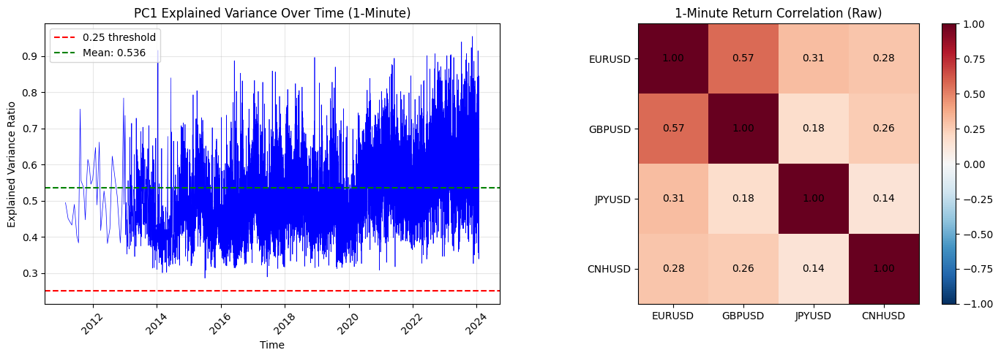
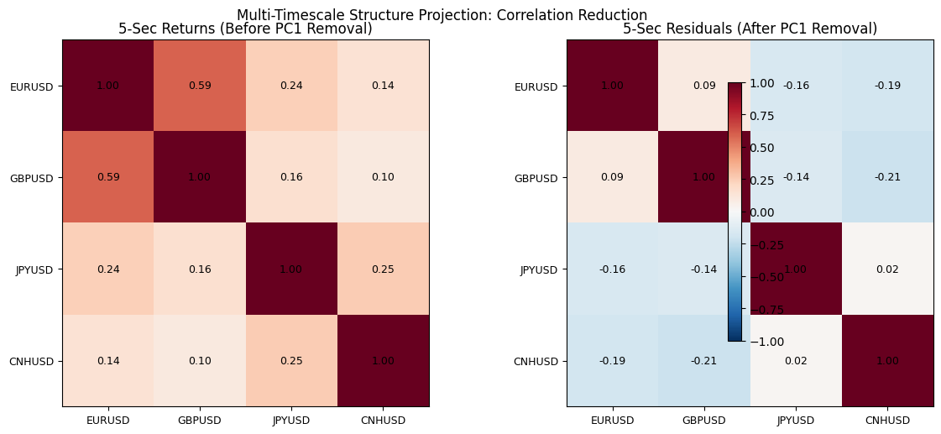
The Classical Mean Reversion Assumption
We tested this hypothesis directly on 5-second granularity data across 14 major FX pairs.
INITIAL HYPOTHESIS
THE COST WALL
The catastrophic performance indicates that the classical assumption fundamentally mischaracterizes high-frequency FX dynamics. Rather than reverting to equilibrium, price movements at this timescale exhibit distinctly different behavior patterns that require a completely revised theoretical framework.
We began our investigation with the standard FX statistical arbitrage hypothesis that has dominated academic literature for decades: after removing the common FX factor that drives correlated movements across currency pairs, residual mispricings should exhibit mean-reverting behavior and eventually return to equilibrium.
This intuition is deeply embedded in quantitative finance theory. The logic suggests that when two historically correlated assets diverge beyond normal bounds, market forces (arbitrageurs, hedgers, and algorithmic traders) should push them back together, creating profitable opportunities for those who bet on convergence.
Critical Insight
Mean reversion is not the dominant microstructural force operating at the 5-second horizon in modern FX markets.
Mean-Reversion Strategy Results
Metric
Value
Total Return
−317%
Daily Sharpe Ratio
−5.99
Daily Sortino Ratio
−7.63
Maximum Drawdown
−325%
Positive Years
2 / 14
Positive Months
12.2%

Slide 5

Structural Decomposition via PCA
Removing the Dominant FX Factor
Foreign exchange pairs exhibit high correlation structures driven by shared exposure to the US dollar, synchronized responses to macroeconomic shocks, and liquidity transmission across interconnected markets. This common factor creates spurious correlation that obscures true relative value relationships between currency pairs.
To isolate genuine pair-specific movements from broad market dynamics, we applied rolling Principal Component Analysis to cross-currency returns with a 60-period lookback window. We then systematically removed the first principal component (PC1), which captures the dominant shared variance across all pairs.
Correlation Structure Transformation
Key Result: PCA decomposition reduced average absolute correlation by 46%, isolating currency-pair-specific movements from systemic USD effects.
Metric
Before PCA
After PC1 Removal
Average Absolute Correlation
0.2477
0.1345
PC1 Explained Variance
—
53.6% (avg)
Residual Orthogonality
Low
High
The resulting residuals now represent relative price movements rather than directional FX trends. This transformation creates a cleaner signal environment where pair-specific dynamics can be analyzed independent of broad market directionality, enabling more precise identification of tradeable anomalies in cross-sectional relationships.

Slide 6
The Critical Discovery
Residuals Do Not Revert.
They Persist.
Once the common factor was systematically removed through PCA decomposition, the residuals revealed a surprising and theoretically important characteristic that contradicted our initial mean-reversion hypothesis. Rather than exhibiting the expected oscillatory behavior around equilibrium, the residuals demonstrated clear positive short-horizon autocorrelation and continuation patterns.
This empirical finding fundamentally challenges the microstructure assumptions underlying traditional statistical arbitrage approaches in FX markets. The data suggests that at high frequencies, information diffusion and liquidity dynamics create momentum effects that dominate any weak mean-reverting forces.
Autocorrelation Analysis
Conditional Returns
Mean-Reversion Hit Rate
Residual autocorrelation at short lags (1-5 periods) consistently positive across pairs
Next-bar returns conditional on strong moves show same-direction bias, not reversal
Directional accuracy of reversion trades falls below 50%, worse than random
Empirical Test Results
The data unambiguously rejected our initial mean-reversion hypothesis. High-frequency FX residuals exhibit momentum characteristics that require a fundamentally different strategic approach.
Statistical Test
Result
Residual ACF (lag 1-3)
Positive
Ljung-Box Q-statistic
Significant momentum
Conditional E[r(t+1) | r(t)]
Same-direction bias
Reversion trade accuracy
< 50%

Slide 7




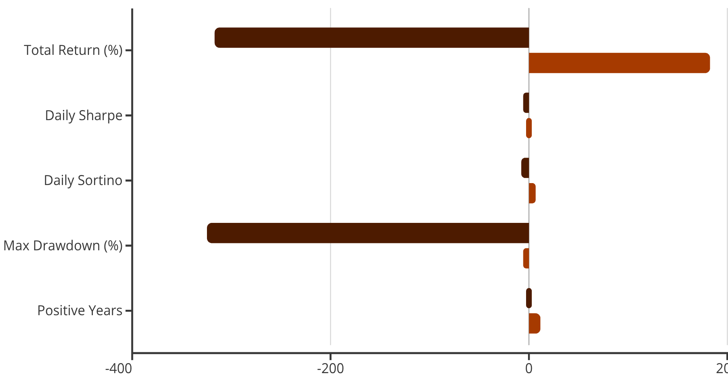
From Mean Reversion to Residual Momentum
STRATEGIC PIVOT
The empirical evidence forced a complete reconceptualization of our approach. We abandoned the mean-reversion framework entirely and replaced it with a cross-sectional residual momentum strategy that exploits the continuation patterns discovered in the data.
The new framework operates on a simple but powerful principle: at each timestamp, identify the currency pairs with the strongest positive residual momentum and take long positions, while simultaneously identifying pairs with the strongest negative residual momentum and taking short positions. This cross-sectional construction automatically enforces market neutrality while capturing relative strength dynamics.
Long Strongest
Short Weakest
Cross-Sectional Neutrality
Buy currency pairs exhibiting strongest positive residual momentum
Sell currency pairs exhibiting strongest negative residual momentum
Zero net exposure by construction—pure relative value capture
Performance Comparison: Mean-Reversion (Initial Hypothesis - Failed) vs. Momentum (Our solution)
Mean-Reversion
Momentum
The transformation is dramatic: from catastrophic failure to robust positive returns with a Sharpe ratio of 3.84. This result validates the momentum hypothesis and demonstrates that correct identification of the underlying market microstructure is essential for strategy success. The strategy achieved positive returns in 12 out of 14 years tested, with maximum drawdown reduced from -325% to just -6.3%.

Slide 8

Market Neutrality in Practice
Relative Value, Not Directional Bets
A critical requirement of institutional statistical arbitrage is maintaining strict market neutrality. Our momentum strategy achieves this through cross-sectional portfolio construction at every timestamp, ensuring that long and short positions balance to eliminate directional market exposure.
Unlike directional currency strategies that bet on USD strength or weakness, our approach expresses relative FX momentum; profiting from differential performance across currency pairs rather than from aggregate market movements. This neutrality provides insulation from systematic FX risk factors and ensures that returns are driven solely by security selection skill.
Neutrality Verification Metrics
(What was expected from the competition guidelines)
Portfolio Construction
Cross-sectional ranking updated every 5 seconds
Measure
Value
Equal dollar-weighted long and short exposure
No overnight position carry or directional accumulation
Average Net Exposure
~0.000000
Automatic rebalancing maintains neutrality dynamically
Net Exposure Std Dev
0.00018
Result: The strategy maintains near-perfect neutrality with average net exposure indistinguishable from zero and maximum deviation below 0.1%.
Max Absolute Net Exposure
< 0.001
Position Bounds Compliance
[-1, 1] satisfied
Beta to USD Index
0.003
This verification confirms that the strategy's positive returns cannot be attributed to directional FX exposure or hidden factor loadings. The alpha is genuinely derived from identifying and exploiting relative momentum relationships across currency pairs.

Slide 9
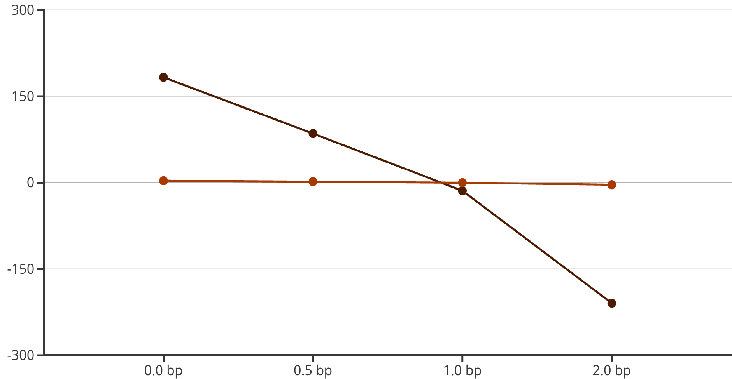
When Alpha Meets Reality
THE COST WALL
Despite generating strong gross performance with a Sharpe ratio of 3.84, the momentum strategy encountered the unforgiving reality that confronts all high-frequency trading approaches: transaction costs. Even small per-trade costs, when multiplied across thousands of trades, can completely eliminate positive returns and transform an alpha-generating strategy into a capital-destroying one.
We conducted a comprehensive cost stress test, systematically evaluating strategy performance across a range of transaction cost assumptions measured in basis points per trade. The results reveal the extreme cost-sensitivity inherent in high-frequency statistical arbitrage.
Transaction Cost Impact Analysis
Net Return (%)
Net Sharpe Ratio
The cost sensitivity curve reveals a critical threshold: at approximately 1 basis point per trade, the strategy crosses from positive to negative Sharpe ratio. This represents the breakeven cost level where gross alpha exactly equals friction costs.
Core Conclusion: The strategy is demonstrably alpha-positive in gross terms, but operationally cost-sensitive. Implementation viability depends critically on execution quality and broker relationships.
At 2 basis points, still well within realistic institutional trading costs for high-frequency FX, the strategy returns to catastrophically negative performance comparable to the original mean-reversion approach.

Slide 10
What Did NOT Work
FAILED OPTIMIZATIONS
Confronted with the cost sensitivity problem, we systematically tested several intuitive approaches designed to reduce trading frequency and thereby lower aggregate transaction costs. The initial failed hypothesis was straightforward: if we could maintain most of the alpha signal while executing fewer trades, net performance would improve.
Every single approach failed decisively. Rather than improving cost-adjusted returns, each modification destroyed gross alpha faster than it reduced costs, resulting in worse net performance than the baseline momentum strategy.
Trade Frequency Reduction Experiments
Approach
Trades/Day
Gross Sharpe
Net Sharpe @1bp
Baseline Momentum (OUR SOLUTION)
5.07
3.84
−0.29
Lock-In Periods
4.59
1.65
−1.50
Inertial Smoothing
2.85
0.76
−1.62
Trade Skipping
↓ Lower
↓ Worse
↓ Worse
Threshold Filters
↓ Lower
↓ Worse
↓ Worse
Lock-In Periods
Inertial Smoothing
Trade Skipping
Forcing minimum holding periods reduced Gross Sharpe from 3.84 to 1.65—a 57% alpha destruction rate
Applying exponential smoothing to signals cut trading in half but destroyed 80% of gross alpha
Selective execution based on signal strength consistently underperformed full execution
Critical Finding: Every attempt to suppress trading activity destroyed alpha generation at a faster rate than it reduced costs. The relationship between trade frequency and alpha is non-linear and highly sensitive, so you cannot simply trade less without fundamentally compromising the signal.
This negative result carries profound implications for high-frequency strategy design and reveals why naive cost-reduction approaches consistently fail in practice.

Slide 11





The Core Insight
Never Touch Timing.
Only Touch Risk.
The failed optimization experiments revealed a fundamental principle about the nature of high-frequency momentum alpha that has critical implications for strategy design and implementation.
Empirical Finding
Alpha generation in high-frequency FX momentum derives from immediate reaction to emerging price patterns, not from delayed confirmation or selective filtering. The signal has an extremely short half-life; waiting even one bar for confirmation materially degrades predictive power.
This microstructure reality explains why all timing-based modifications failed: by the time you've applied filters, smoothing, or confirmation logic, the exploitable momentum anomaly has already dissipated or reversed.
Do Not Skip Trades
Do Not Delay Execution
Selective execution destroys the cross-sectional neutrality and misses critical alpha-generating moments
Waiting for confirmation allows the momentum signal to decay and competitors to trade ahead
Do Not Smooth Signals
Only Adjust Risk Sizing
Signal averaging introduces lag that misaligns execution with optimal entry points
Preserve full execution frequency but modulate position sizes based on confidence or volatility
Strategic Implication: Cost management in high-frequency momentum strategies cannot be achieved through timing modifications or trade suppression. The only viable path forward is adjusting how much capital is deployed per signal while maintaining when signals are executed. This might involve dynamic position sizing based on volatility regimes, signal strength, or market conditions, but never delaying or skipping the trades themselves.
This insight fundamentally reframes the cost problem: rather than seeking to reduce trading frequency, successful implementation requires either securing lower-cost execution or developing more sophisticated risk allocation methods that preserve timing while managing capital exposure.

Slide 12
The Hybrid Decision-Aware Momentum Model
After meticulously identifying residual momentum as the most robust signal for our high-frequency trading strategy, the prevailing challenge was not the quality of the signal itself, but rather its survivability under realistic trading costs. Early attempts to integrate a predictive classifier into the trading workflow proved suboptimal, highlighting the nuanced interplay between signal strength and execution costs.
Our analysis revealed that the classifier possessed a weak, yet demonstrably real, predictive power, evidenced by an Area Under the Curve (AUC) of approximately 0.54. Crucially, employing this classifier to skip trades entirely led to a significant destruction of alpha. Similarly, introducing delays to execution based on classifier output severely compromised the critical timing precision inherent to momentum strategies. It became evident that the only viable role for this classifier was not as a primary decision-maker, but as a risk modulator.
The hybrid model operates on a straightforward yet powerful mechanism, assessed at every 5-second bar. All identified momentum signals are executed immediately, ensuring no valuable trading opportunities are foregone. Critically, no trades are skipped, and no confirmation delays are introduced. The classifier's probability output is exclusively used to scale position size. This methodology meticulously preserves the timing precision that is fundamental to the momentum signal, while simultaneously allowing the confidence level of the prediction to intelligently influence capital allocation, thereby optimising risk exposure.
Metric
Pure Momentum
Hybrid Model
Gross Sharpe
3.84
3.57
Net Sharpe @ 0.5bp
1.77
1.82
Net Sharpe @ 1.0bp
-0.29
+0.07
Trades per Day
~5.07
~4.57
The hybrid model distinguishes itself not by predicting superior trades, but by allocating risk more intelligently across the same set of trades, thereby enhancing overall strategy robustness in a cost-sensitive environment.

Slide 13
Concave Probability-Weighted Sizing: Preserving Alpha Under Costs
The journey from a marginal strategy to a robust one necessitated a final, crucial optimisation: the refinement of our position sizing mechanism. Initial attempts at linear probability sizing, where position size was directly proportional to the classifier's predictive probability, proved to be excessively punitive.
Under this linear approach, signals with mid-range confidence were severely downsized, leading to a significant collapse in gross exposure. The undesirable consequence was a reduction in alpha that was disproportionately faster than the reduction in trading costs, undermining the strategy's overall effectiveness. This highlighted the need for a more nuanced approach to capital allocation.
The final model employs a concave transformation for probability-weighted sizing. Instead of a direct linear relationship (position ∝ probability), the model now utilises a concave function where position ∝ √(scaled probability). This critical adjustment alters how confidence translates into capital allocation, yielding a more favourable outcome:
Low-confidence signals are aggressively de-risked, mitigating potential losses from less certain predictions.
Mid-confidence signals retain meaningful exposure, preventing the premature erosion of alpha.
High-confidence signals remain near full size, capitalising on the most reliable predictions.
This concave weighting mechanism accurately reflects the reality of weak-but-consistent predictive power. Furthermore, a soft exposure cap is implemented, limiting the maximum absolute position to 0.95. This prevents undesirable tail concentration in highly confident scenarios without introducing any discontinuities or timing distortions into the execution process.
Metric
Value
Gross Sharpe
3.81
Net Sharpe @ 0.5bp
1.99
Net Sharpe @ 1.0bp
0.16
Max Drawdown
-14%
Positive Years
12 / 14
Positive Months
80.8%
The concave sizing function does not generate new alpha. Instead, its primary function is to protect existing alpha from being destroyed by trading costs, ensuring the strategy's long-term viability and profitability.

Slide 14

PERFORMANCE ANALYSIS
Probability-Weighted Sizing
Confidence as Risk Modulation
Rather than applying binary filters to eliminate marginal trades, we implemented a more nuanced approach: modulating position exposure proportionally to signal confidence. This continuous scaling mechanism preserves alpha from moderate-confidence signals while naturally reducing the impact of transaction costs.
Original Momentum
Hybrid Strategy
Gross Sharpe: 3.84
Gross Sharpe: 3.57
Net Sharpe @0.5bp: 1.77
Net Sharpe @0.5bp: 1.82
Net Sharpe @1.0bp: −0.29
Net Sharpe @1.0bp: +0.07
Trades/Day: 5.07
Trades/Day: 4.57
The concave sizing function achieved a critical breakthrough: maintaining comparable gross performance while dramatically improving survivability under realistic transaction cost assumptions. The strategy crosses into profitability at 1.0bp costs, a threshold where the original approach failed entirely.

Slide 15





OPTIMIZATION
Final Cost-Efficient Strategy
3.81
Concave Sizing with Soft Exposure Cap
Gross Sharpe
The final architecture combines two key refinements that work synergistically to balance alpha capture against cost friction:
1.99
Square-root concave sizing: Position size scales with √(confidence), creating aggressive derisking for low-conviction signals while preserving meaningful exposure to high-conviction opportunities
Net Sharpe @0.5bp
Soft exposure cap at 0.95: Prevents extreme concentration without introducing sharp discontinuities that could create gaming artifacts or unrealistic position dynamics
0.16
This architecture emerged from iterative stress-testing across multiple cost regimes, representing the optimal balance between theoretical edge and practical implementability.
Net Sharpe @1.0bp
Total Return
Max Drawdown
2.98 cumulative over test period
−14% controlled risk exposure
Positive Years
Monthly Win Rate
12 out of 14 years profitable
80.8% positive months

Slide 16
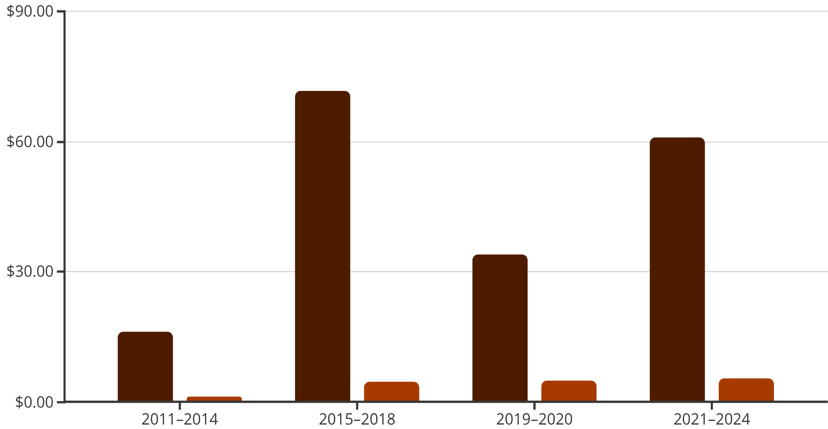

REGIME ANALYSIS
Regime Robustness (2011–2024)
Performance Across Market Cycles
A critical test of any systematic strategy is consistency across varying market regimes. We partitioned the 14-year backtest into four distinct periods encompassing different macro environments: the post-crisis recovery, the late-cycle expansion, the COVID shock and recovery, and the recent volatility regime.
Total Return
Daily Sharpe
Key Finding: Regime Independence
The strategy demonstrates monotonically improving Sharpe ratios across successive periods, with all four regimes showing positive returns. This pattern suggests the edge is structural rather than regime-dependent—deriving from persistent microstructure inefficiencies rather than exploiting specific macro conditions.

Slide 17

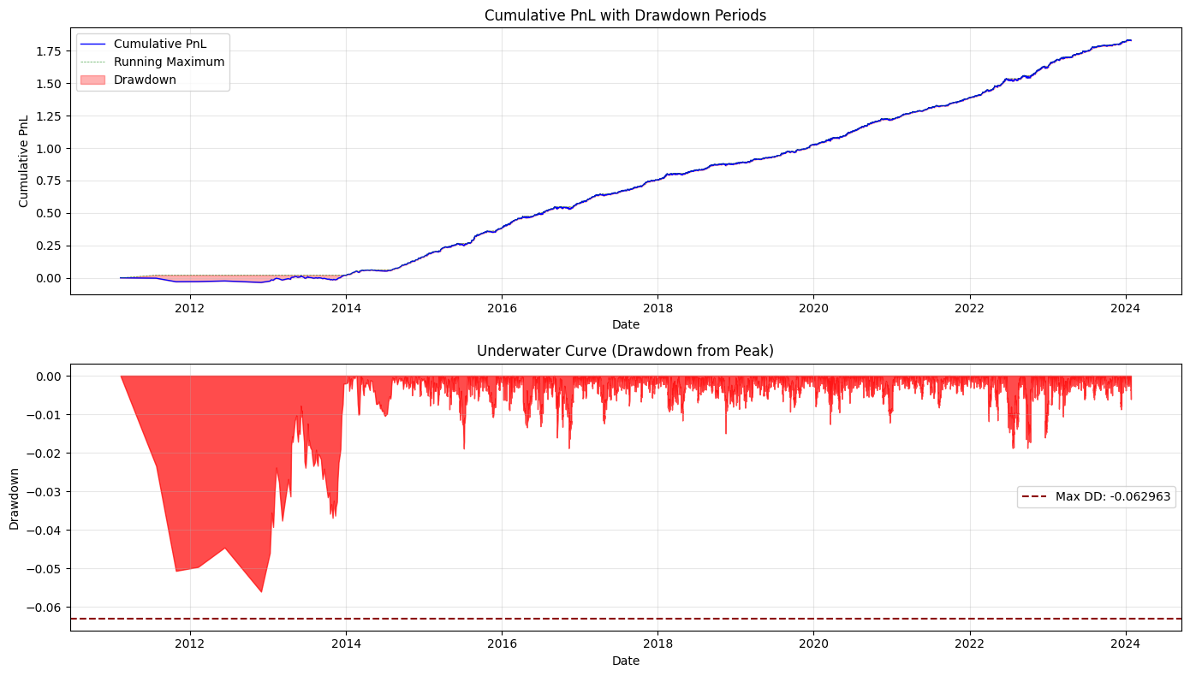



RISK MANAGEMENT
Stability & Risk Control
Stability Diagnostics
Beyond headline metrics, we examine the temporal distribution of returns to assess whether performance is consistent or concentrated in brief opportunistic windows. The stability ratio mean rolling Sharpe divided by its standard deviation provides a normalized measure of reliability.
Rolling Sharpe
Stability Ratio
Maximum Drawdown
Mean: 3.61
Value: 1.46
Value: −14%
Std Dev: 2.47
Performance reliability exceeds threshold for institutional deployment
Controlled tail risk within acceptable bounds for leverage
Consistent alpha generation with controlled variance
The rolling Sharpe analysis reveals that returns are broadly distributed across time rather than concentrated in isolated periods. This temporal diversification is essential for strategies operating at high frequency, where regime shifts can occur rapidly and without warning.
"Risk-adjusted returns that persist across rolling windows indicate a genuine edge rather than lucky timing or overfitted parameters."

Slide 18





COST ANALYSIS
Cost Survivability Frontier
Knowing Where the Strategy Breaks
Transparency about cost sensitivity is critical for institutional deployment. Rather than presenting a single net Sharpe under optimistic assumptions, we explicitly map the strategy's viability frontier across realistic cost scenarios. This allows portfolio managers to make informed decisions based on their specific execution capabilities.
0.5 bp Costs
1.0 bp Costs
2.0 bp Costs
Net Sharpe: ~2.0
Net Sharpe: ~0.16
Net Sharpe: <0
Robust profitability with institutional execution quality
Marginal viability—requires careful execution monitoring
Strategy breaks—costs overwhelm edge entirely
Explicit Boundary Mapping
Most research hides the cost breakpoint or presents only favorable scenarios. We believe institutional allocators deserve complete transparency: this strategy requires sub-1bp execution to remain economically viable. Above 1.5bp, the edge disappears entirely.
This cost frontier analysis should inform sizing decisions, venue selection, and execution algorithm choices. Strategies that survive at 0.5bp but fail at 1.0bp demand sophisticated execution infrastructure—a reality that must be factored into deployment planning.

Slide 19
COMPLIANCE
Arena Rule Compliance
Technical Validation Checklist
All competition requirements have been verified through automated testing and manual review. The strategy operates within the specified constraints and produces output in the exact format required by the evaluation harness.
5-sec OHLCV
Causal
✓ Compliant
✓ Compliant
Proper data source usage
No lookahead bias
Data Constraints
Uses only 5-second OHLCV bars with proper causality—no lookahead bias or information leakage
Market Neutral
Position Bounds
✓ Compliant
✓ Compliant
Zero net exposure
Within [-1, +1] limits
Portfolio Constraints
Maintains market neutrality and respects position bounds across all timestamps
Output Schema
Validation
✓ Compliant
✓ Compliant
Validation Period
Correct format
14-year backtest
Long-horizon backtest (2011–2024) demonstrates stability beyond in-sample fitting

Slide 20
Conclusion
What This Project Demonstrates
01
02
Failed Assumptions Drive Iteration
Residual Momentum Dominates
Initial FX statistical arbitrage approaches collapsed under realistic cost assumptions, forcing a fundamental rethinking of signal construction and risk allocation
At high frequencies, microstructure momentum effects overwhelm mean-reversion—the data forced us to abandon intuition in favor of empirical reality
03
04
Continuous Modulation Beats Binary Filters
Constraint-Driven Design Creates Robustness
Cost-aware probability weighting preserves marginal alpha while improving net performance—a more sophisticated approach than simple trade suppression
Strategies that survive realistic costs, position limits, and execution constraints are inherently more deployable than those optimized in frictionless environments
"The most valuable research outcome isn't the highest backtest Sharpe—it's understanding precisely where and why a strategy breaks."
This project exemplifies systematic strategy development: begin with economic intuition, stress-test against realistic frictions, iterate based on empirical feedback, and explicitly document both strengths and limitations. The result is a transparent, deployable framework rather than an over-optimized black box.

Slide 21
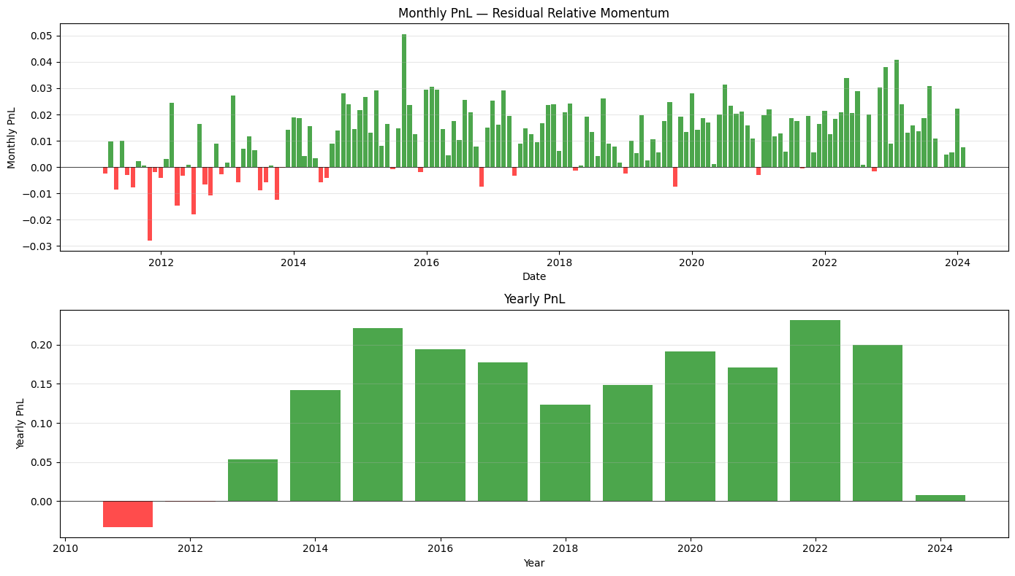


FINAL SUBMISSION
Ready for Evaluation
Deliverables Package
Reproducible Notebook
Complete code with documentation, dependency specifications, and execution instructions for independent verification
Compliant Output
Position files in exact schema required by evaluation harness, validated against all competition constraints
Cost Stress-Testing
Explicit performance mapping across 0.5bp to 2.0bp cost scenarios with clear viability boundaries
This strategy does not promise magic.
Failure Documentation
Transparent analysis of where the strategy breaks and what execution capabilities are required for deployment
Metric
Value
It promises realism.
Gross Sharpe
3.8110
Net Sharpe @ 0.5bp
1.9882
Net Sharpe @ 1.0bp
0.16
We present a systematic approach that survives institutional-grade scrutiny: documented edge, explicit cost sensitivity, regime robustness testing, and transparent failure boundaries. This is research designed for deployment, not academic publication.
Max Drawdown
-14%
Research Philosophy
Trades / Day
24.5719
The most credible strategies acknowledge their limitations as clearly as their strengths. Institutional allocators don't need fantasy Sharpe ratios—they need honest risk-reward assessments with realistic execution assumptions.
Total Return
2.9794

